Slide 1
AIR QUALITY ANALYSIS (on the basis of PM10)
STATISTICS PROJECT
Jayshri Gupta
Pravesh Raikwar

Slide 2
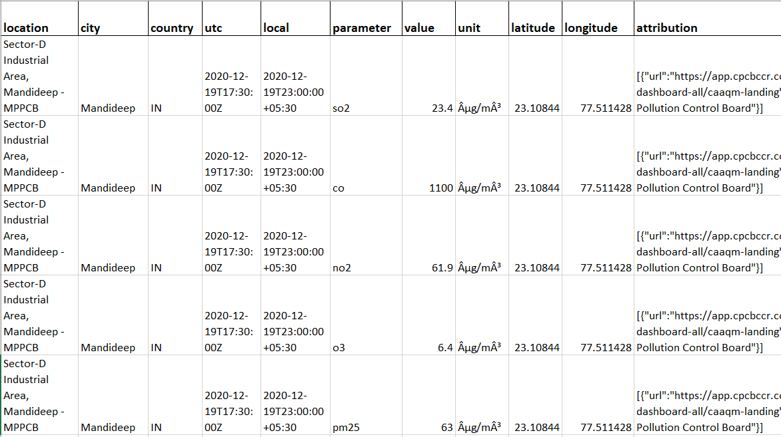
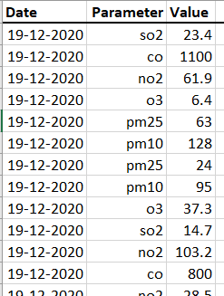
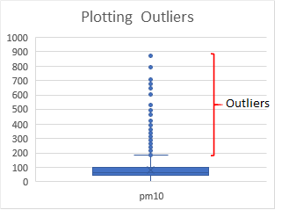
DATA and DATA CLEANING:
Original Data
Data into Consideration
DATA CLEANING:
Outlier identification method: IQR
Outlier replacement: Mean of the population

Slide 3
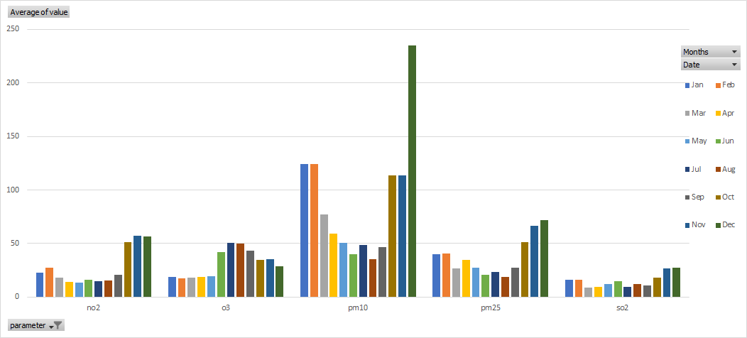
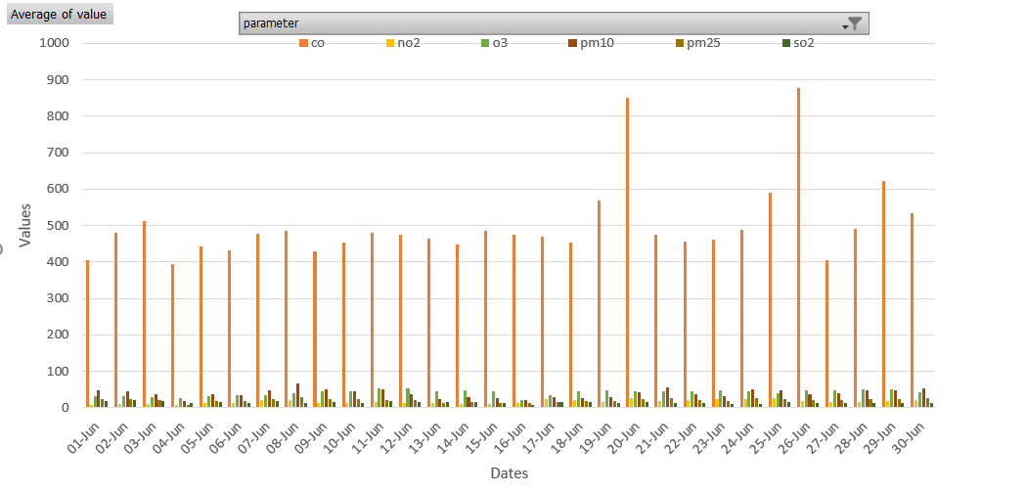
VISUAL ANALYSIS
Date-wise Plot of different parameters for June
Monthly bar plot of different parameters

Slide 4
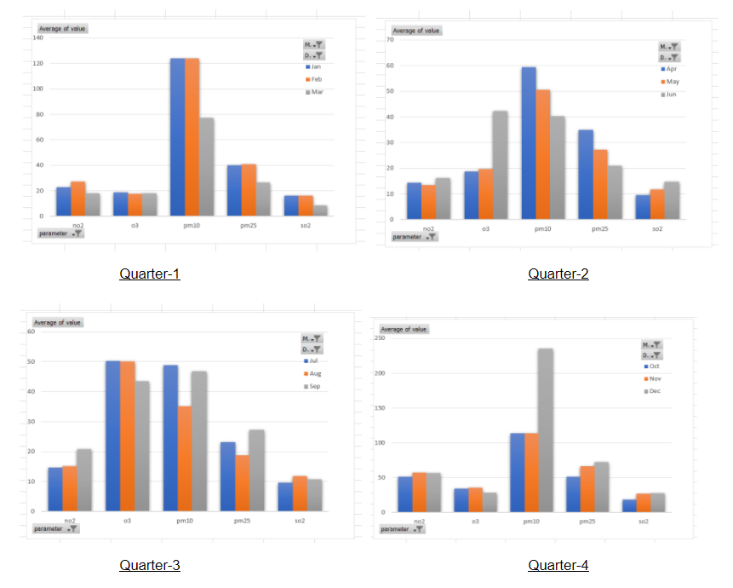
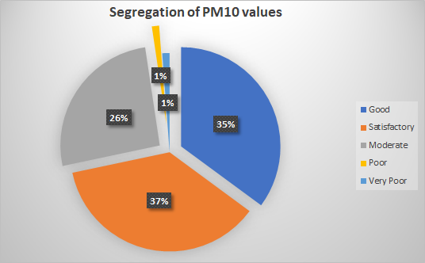
Yearly Analysis of PM10 values segregating them into different categories according to their standard values and health impact.
Quarterly analysis of different Parameters

Slide 5
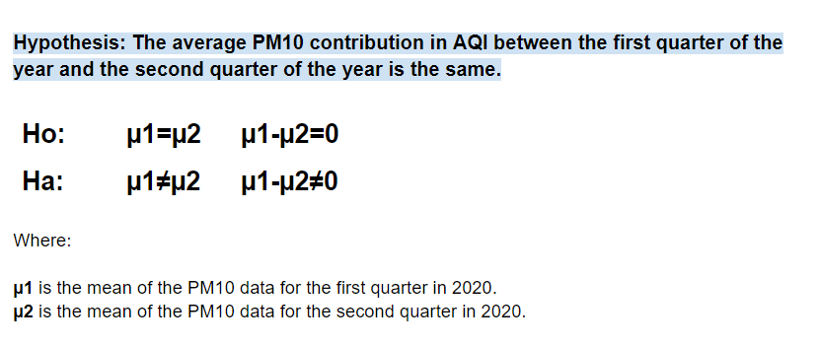
HYPOTHESIS TESTING
Proportions into consideration:
Proportion 1 : The entire cleansed data of the first three months(January,2020 to March, 2020) of PM10 having 5251 data points.
Proportion 2 : The entire cleansed data of the first three months(January,2020 to March, 2020) of PM10 having 3904 data points

Slide 6
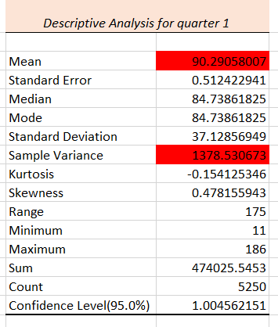
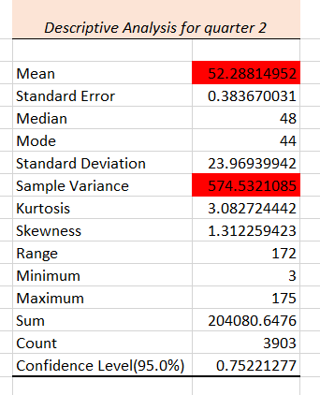
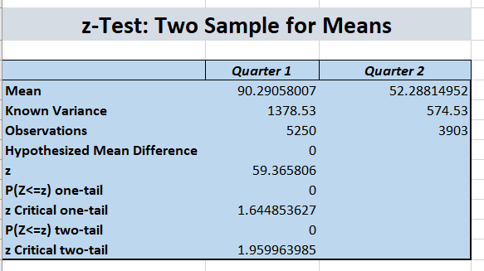
Test used:
Two-tailed test
z-Test: Two Sample for Means
Reasons:
Normally distributed data
Independent proportion
Large sample size

Slide 7
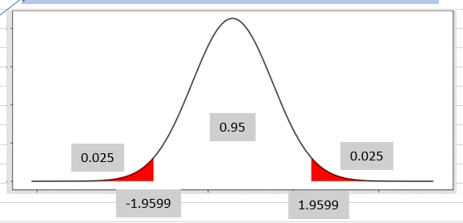
Conclusion of
Hypothesis Test:
The average PM10 contribution in AQI between the first quarter of the year and the second quarter of the year is not the same.
Conclusion:
(z value) 59.366 >> 1.959 (z critical)
z value significantly greater than z critical two-tail, hence we neglect null hypothesis and suggest alternative hypothesis.

Slide 8
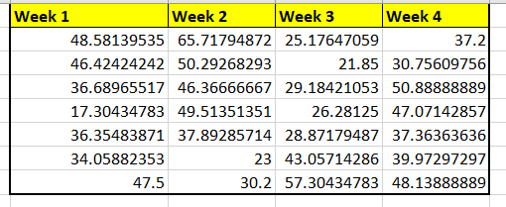
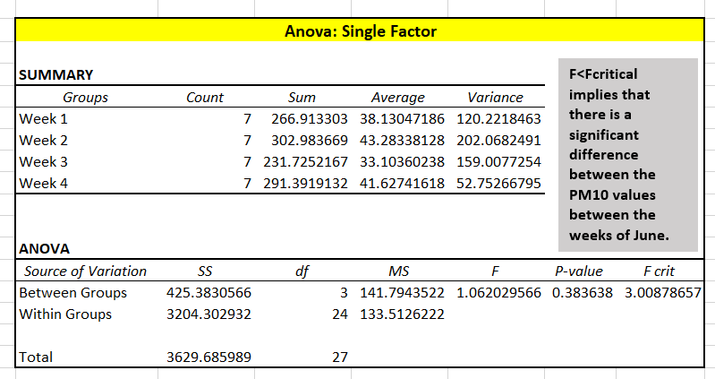
ANOVA(Analysis of Variance)
Comparison of PM10 data between different weeks of June, 2020. The data used is displayed below.
Carrying out Anova: Single Factor test on the above data to analyse if there is a difference between the week 1, week 2, week 3, and week 4 of June, 2020.
F < F_{Critical}
We conclude that there is a significant difference between the PM10 values between the weeks of June.

Slide 9
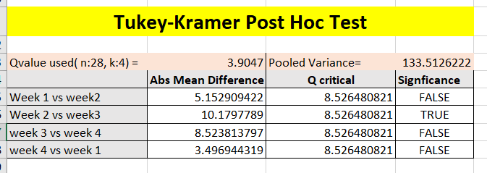
TUKEY’S TEST
We use the Q-value method to analyse the results of the significance difference. We find the Q critical value using the following formula:
Q critical value = Q*√(s² pooled / n)
Q _{critical} = 3.9047 Pooled Variance = 133.513
The difference in means between Week 2 and Week 3 is statistically significant. As |Mean Difference| > Q _{critical.}

Slide 10
THANK YOU.

